Slide 1
Pictorialism vs Realism
Martin Toft 2010

Slide 2
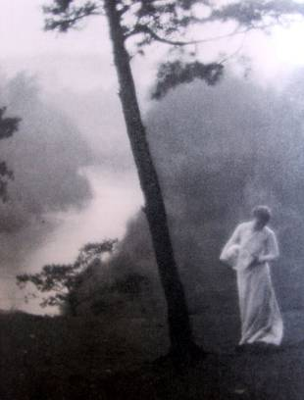
Pictorialism 1880s-1920s
From the 1880s and onwards photographers strived for photography to be art by trying to make pictures that resembled paintings e.g. manipulating images in the darkroom, scratching and marking their prints to imitate the texture of canvas, using soft focus, blurred and fuzzy imagery based on allegorical and spiritual subject matter, including religious scenes.
Pictorialism reacted against mechanization and industrialisation. They abhorred the snapshot and were also dismayed at the increasing industrial exploitation of photography and practices that pandered to a commercial and professional establishment.
The Pictorialists championed evocative photographs and individual expression and they constructed their images looking for harmony of matter, mind and spirit; the first was addressed through objective technique and process, the second in a considered application of the principles of composition and design, and the last by the development of a subjective and spiritual motive.
Clarence H. White, Morning, 1908, Photogravure print

Slide 3
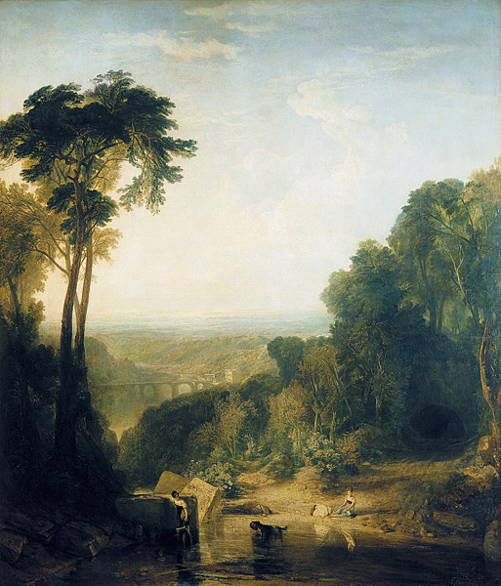
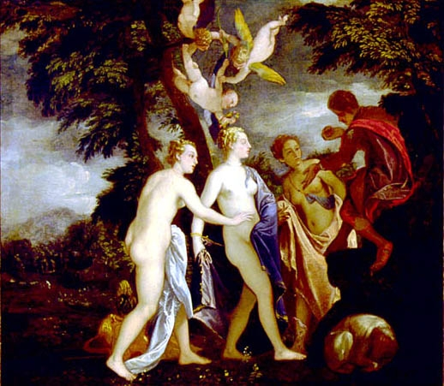
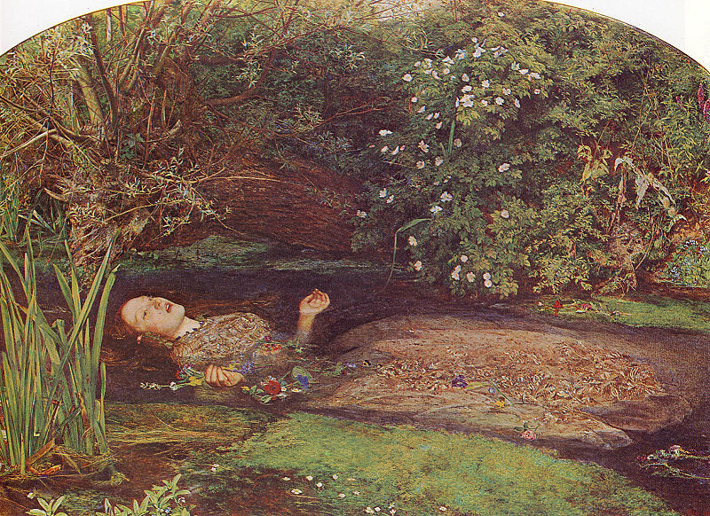
Influences on Pictorialism: Allegorical painting
JMW Turner (1775-1851)
Allegory is a figurative mode of representation conveying meaning other than the literal. Allegory communicates its message by means of symbolic figures, actions or symbolic representation. The underlying meaning has moral, social, religious, or political significance, and characters are often personifications of abstract ideas as charity, greed, or envy. Allegorical painting was dominant in Italian Renaissance art in 16th and continued to be a popular up until the Pre-Raphaelite Brotherhood in the mid 19th century.
Paolo Veronese (1556)
John Everett Millais (1829-1896)

Slide 4
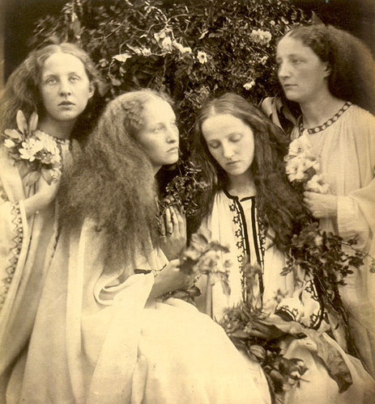
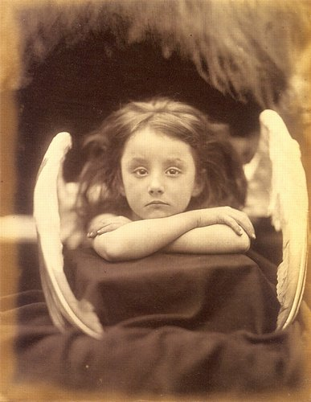
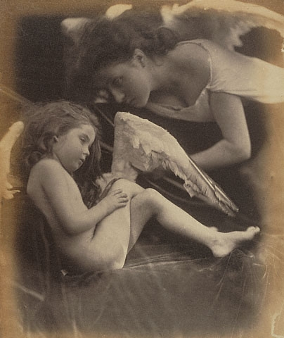
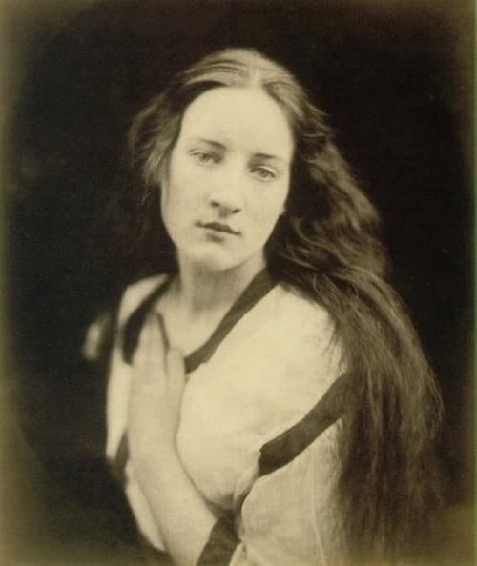
Influences on Pictorialism: Julia Margaret Cameron (1815-1879)
Julia Margaret Cameron was a photographer in the Victorian era. The bulk of Cameron's photographs fit into two categories – closely framed portraits and illustrative allegories based on religious and literary works. In the allegorical works in particular, her artistic influence was clearly Pre-Raphaelite, with far-away looks and limp poses and soft lighting. Cameron’s photographs were unconventional in their intimacy and their particular visual habit of created blur through both long exposures, where the subject moved and by leaving the lens intentionally out of focus.

Slide 5
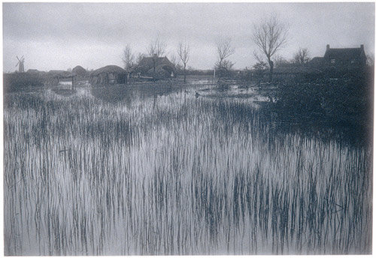
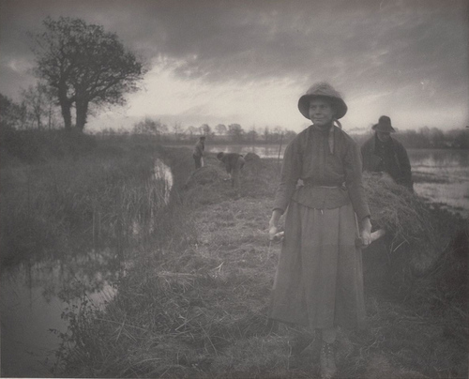
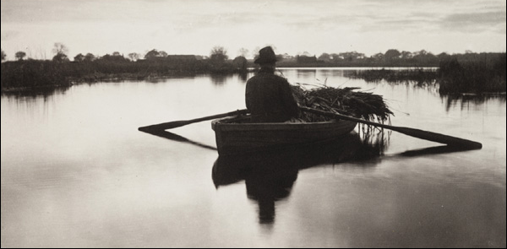
Influences on Pictorialism: Emerson’s Naturalistic Photography
In 1889 Peter Henry Emerson (1856-1936) expounded his theory of Naturalistic Photography which the Pictorialist used to promote photography as an art rather than science. Their handcrafted prints were in visual opposition to the sharp b/w contrast of the commercial print

Slide 6
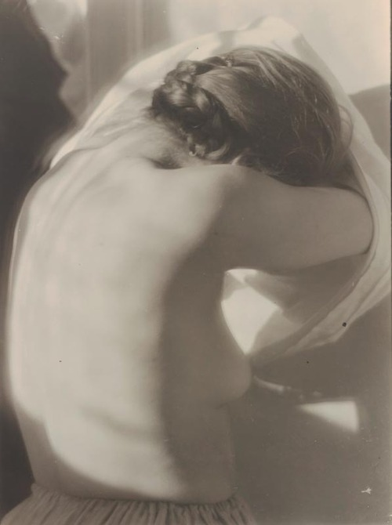
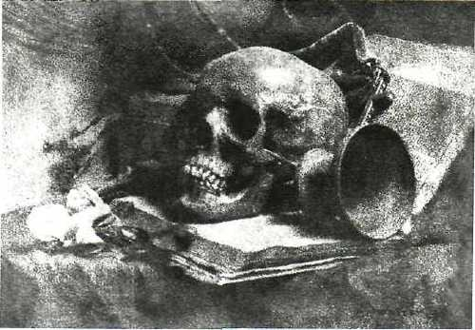
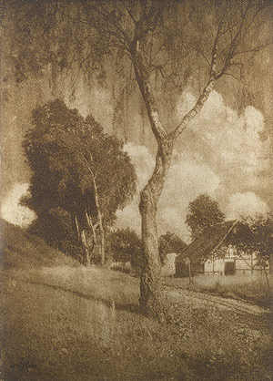
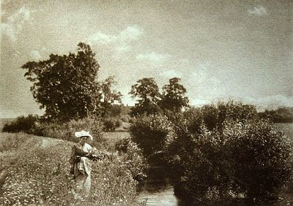
A number of different photographic groups and associations emerged that promoted Pictorialism such as:
The Vienna Camera Club (Austria)
Hans Watcek
Technically Photographic art should imitate the conventions of academic painting showing an arrangement of elements such as figures, foreground interest, peripheral framing and background closure. Pictorialism would purposefully construct a picture – it might be ‘taken’ from nature but it had to be ‘made’.
Heinrich Kuhn
Hugo Henneberg
Hugo Henneberg

Slide 7
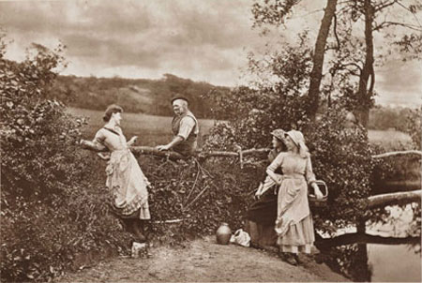
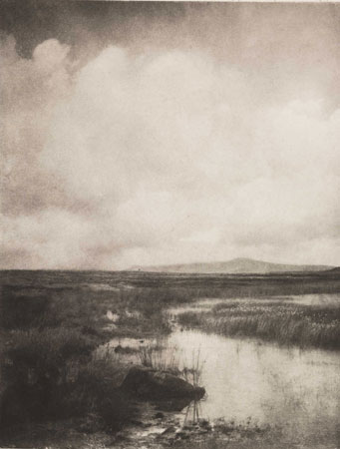
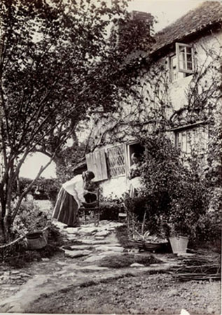
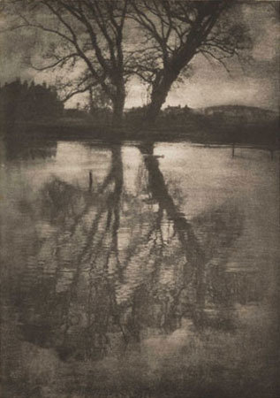
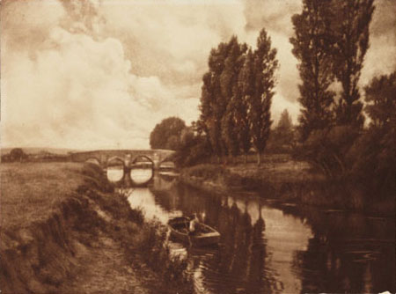
The Brotherhood of the Linked Ring (London)
H P ROBINSON
HE NEVER TOLD HIS LOVE (1884)
ALFRED HORLSEY HINTON
FLEETING AND FAR (1903)
JOSEPH GALE
COTTAGE GARDEN (c 1890)
GEORGE DAVISON
REFLECTIONS (1899
CHARLES JOB
PULBOROUGH BRIDGE (c 1900)

Slide 8
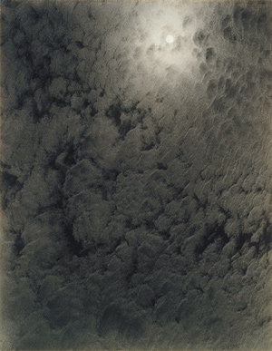
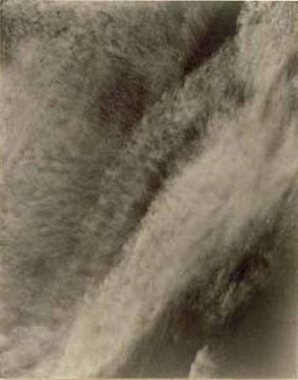
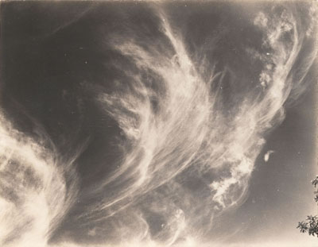
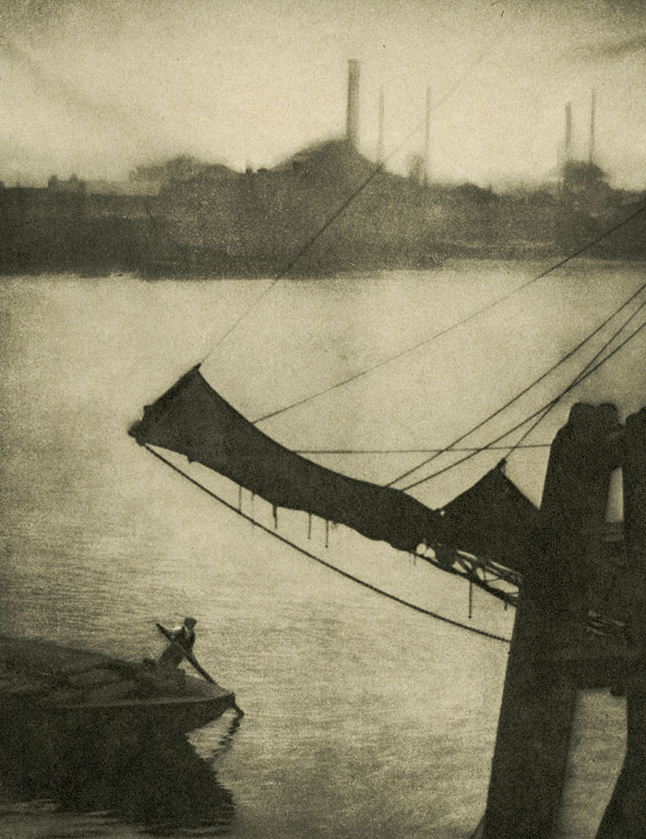
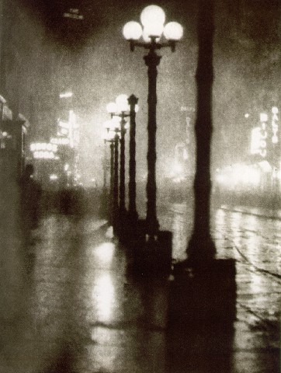
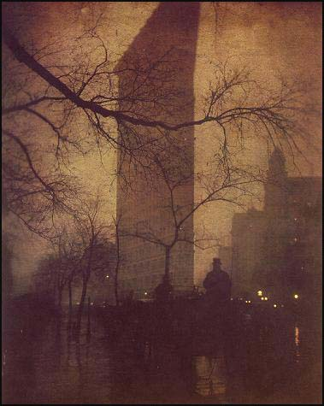
Alfred Stieglitz: Equivalent (cloud studies)
Photo-Secession (New York) founded by Alfred Stieglitz
Alvin Langdon Coburn
Alvin Langdon Coburn
Edward Steichen

Slide 9
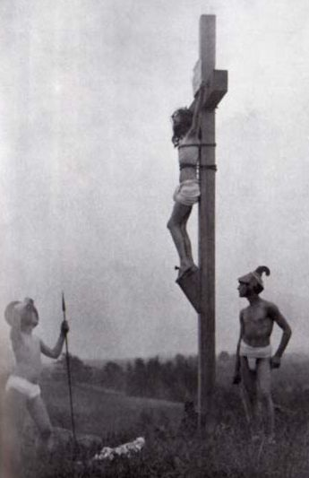
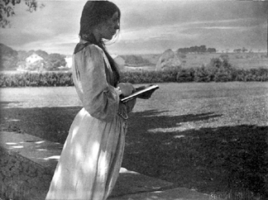
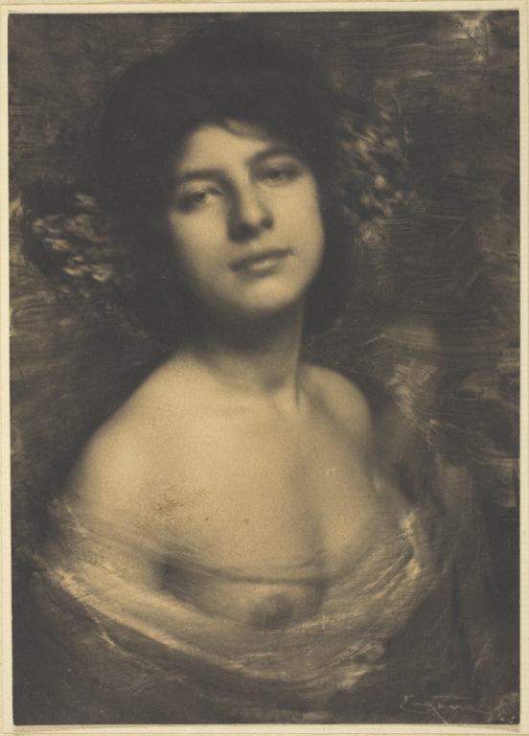
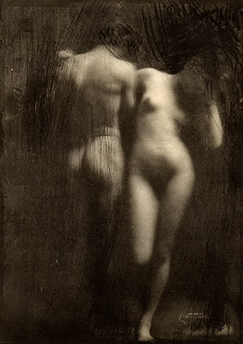
Gertrude Käsebier
Frank Eugene
F Holland Day
Other members of Photo-Secession
Clarence H White
Frank Eugene

Slide 10
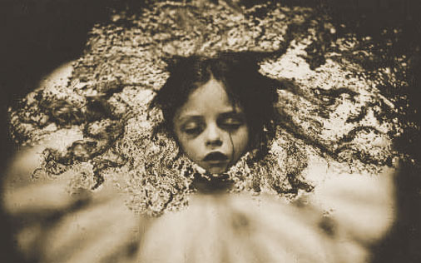
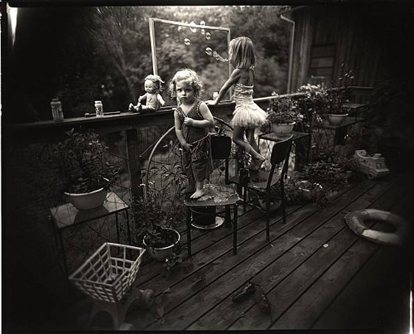
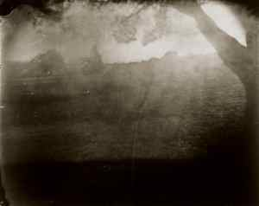
Sally Mann, American (1951-)
Drawing upon her personal experiences as inspiration, Sally Mann creates a haunting series of photographs that speaks about the one subject that affects us all, the loss of life. Dark, beautiful and revelatory, What Remains, created in 2004 is a five-part meditation on mortality, explores the ineffable divide between body and soul, life and death, spirit and earth. This body of work consist of landscape, pictures of decomposing bodies and portraits of her children.

Slide 11
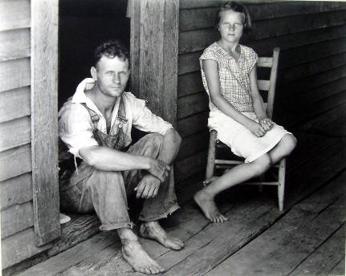
Theory…Straight Photography and Realism
Straight Photography…were photographers who believed in the intrinsic qualities of the photographic medium and its ability to provide accurate and descriptive records of the visual world. These photographers strove to make pictures that were ‘photographic’ rather than ‘painterly’, they did not want to treat photography as a kind of monochrome painting. They abhorred handwork and soft focus and championed crisp focus with a wide depth-of-field.
Walker Evans, Hale Country, 1936
Realism… (closely associated with ‘straight photography’) photography grew up with claims of having a special relationship to reality, and its premise, that the camera’s ability to record objectively the actual world as it appears in front of the lens was unquestioned. This supposed veracity of the photographic image has been challenged by critics as the photographer’s subjectivity (how he or she sees the world and chooses to photograph it) and the implosion of digital technology challenges this notion opening up many new possibilities for both interpretation and manipulation. A belief in the trustworthiness of the photograph is also fostered by the news media who rely on photographs to show the truth of what took place.

Slide 12
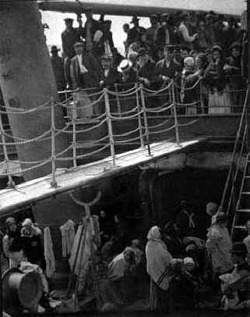
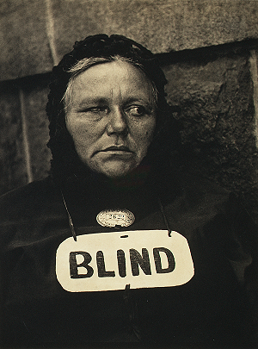
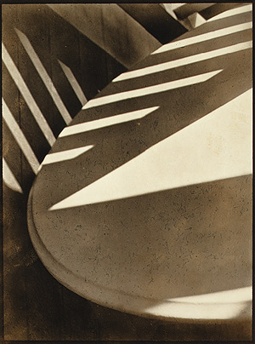
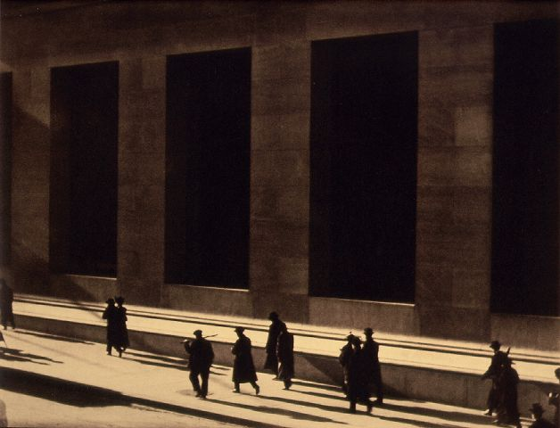
In 1907 Stieglitz took this picture, The Steerage and thereby rejected Pictorialism’s aesthetics and became in favour of what Paul Strand called ‘absolute unqualified objectivity’ and ‘straight photographic means’. Stieglitz and Strand was also influenced by European avant-garde art movements such as Cubism and Fauvism and some of their pictures emphasised underlying abstract geometric forms and structure of their subjects.
Alfred Stieglitz
Paul Strand
Paul Strand
Paul Strand

Slide 13
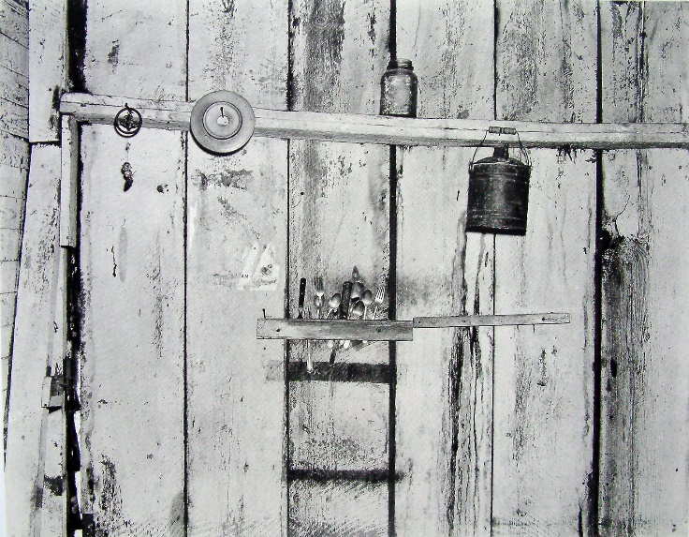
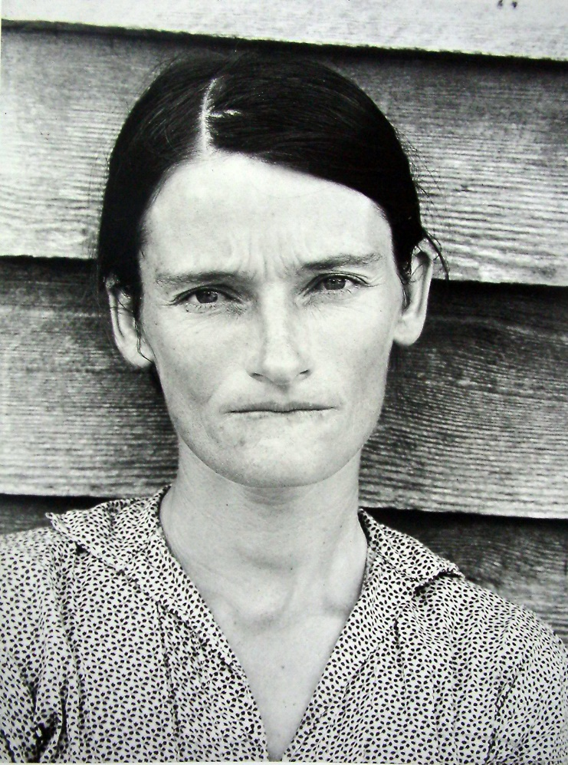
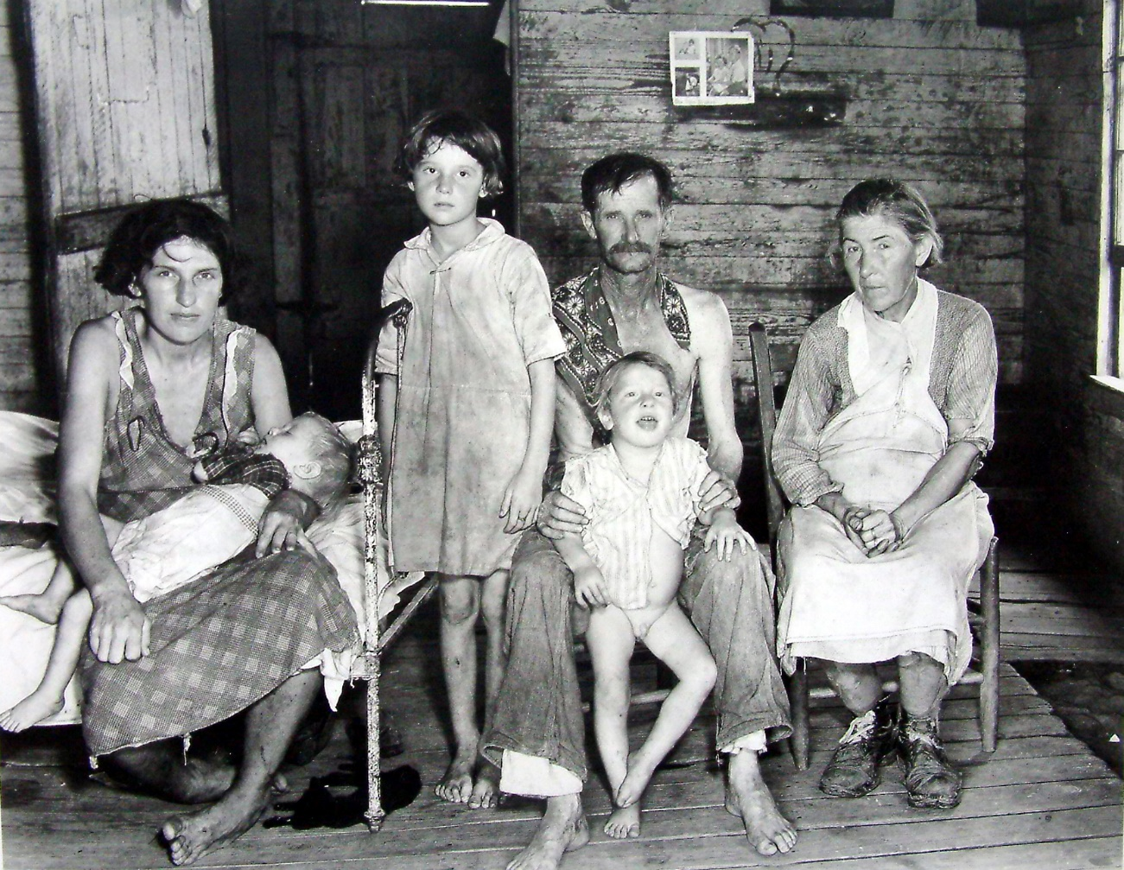
Walker Evans (1903-75)
Often considered to the leading American documentary photographer of the 20th century. He rejected Pictorialism and wanted to establish a new photographic art based on a detached and disinterested look. He most celebrated work is his pictures of three Sharecropper families in the American South during the 1930s Depression.

Slide 14
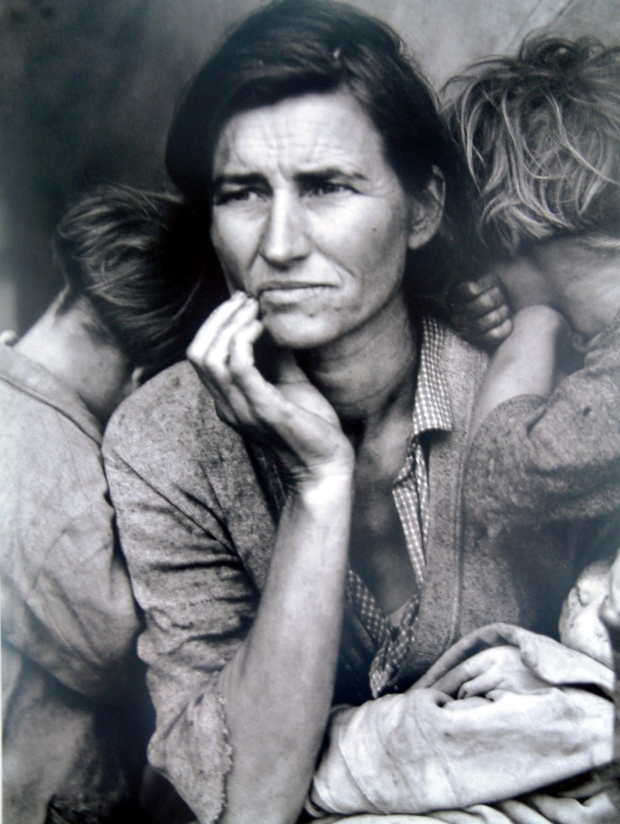
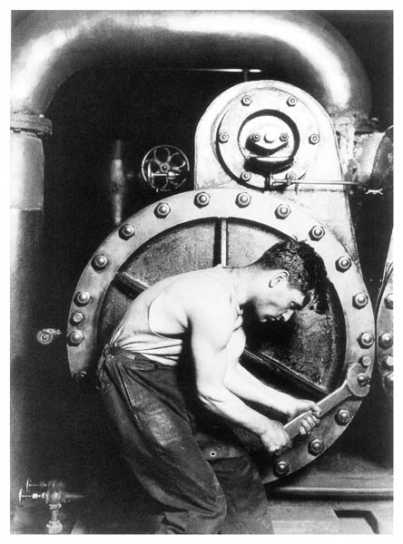
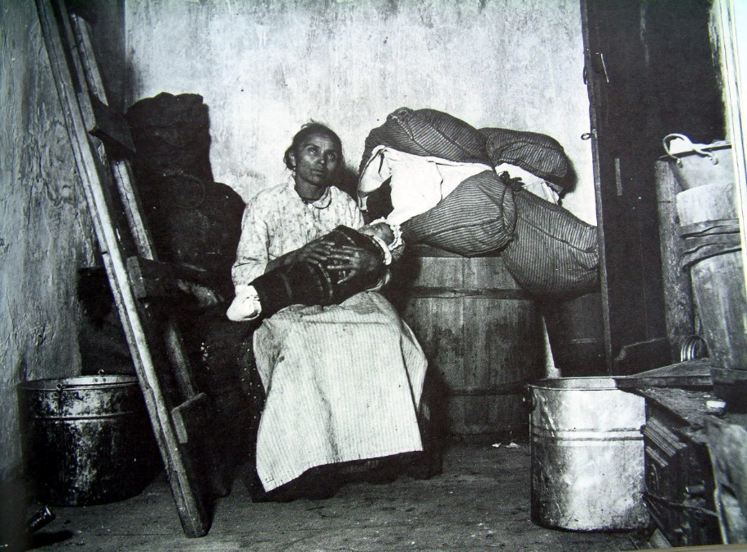
Social Reform photography
The rural poor or the urban environment were not subjects for Pictorial photographers. But when A Danish immigrant , Jacob Riis published his book, How the Other Half Lives’ about the slums of Manhattan a new kind of realism was born with a socialist dimension. A number of photographer’s such as Lewis W Hine and Dorothea Lange began to document the effects of industrialization and urbanization on working-class Americans. Their work brought the
Dorothea Lange
need for housing and labour reform to the attention of legislators and the public and became the origins of what we now call photojournalism.
Lewis W Hine
Jacob Riis

Slide 15
Paul Strand, Blind woman
Dorothea Lange
Lewis Hine
Henry Frederik Evans
Stieglitz rejected pictorialism in 1907 and made Steerage
Lisette Model
Margareth Bourke-White
Modernism: Russian avant-garde: Rodchenko, Moholy-Nagy
Photomontage modernistic
Berenice Abott, Family of Man
Clement Greenberg & Beamont Newhall,
MOMA, John Szarkowski
Modernism in portraiture, fashion, still lives, reportage,

